Slide 1


Computational Intelligence (TC2023)

Slide 2
Unit V – Web System Protection (1)
Outline
What is required to protect a consumer Web?
Types of Abuse - Authentication and Account Takeover

Slide 3

What is required to protect a consumer Web?

Slide 4
What is consumer web?
consumer web: any service accessible over the public internet that provides a product to individual consumers; the service can be free or fee-based.
consumer web attack surfaces:
account access, payment interfaces, and content generation.
Social networks provide another dimension of vulnerability, as attackers can take advantage of the social graph to achieve their goals.

Slide 5
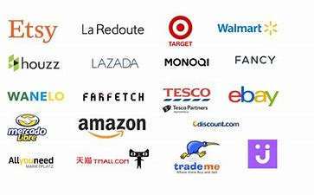
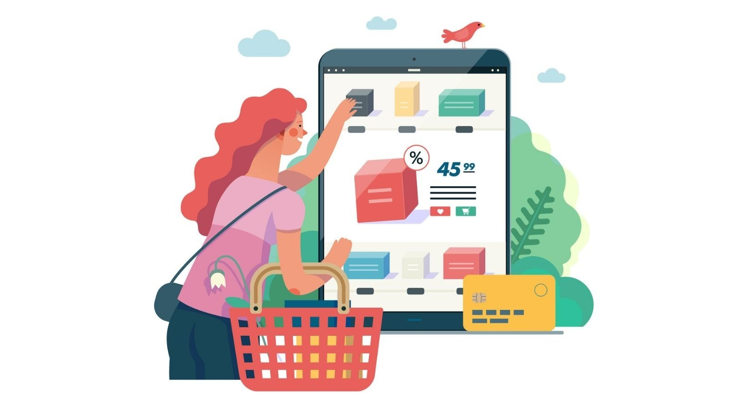
How a hacker directly monetized through attacking web consumer applications?

Slide 6


How a hacker directly monetized through attacking web consumer applications?

Slide 7

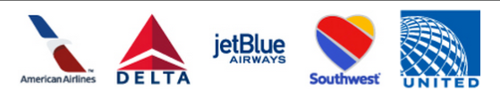
How a hacker directly monetized through attacking web consumer applications?

Slide 8
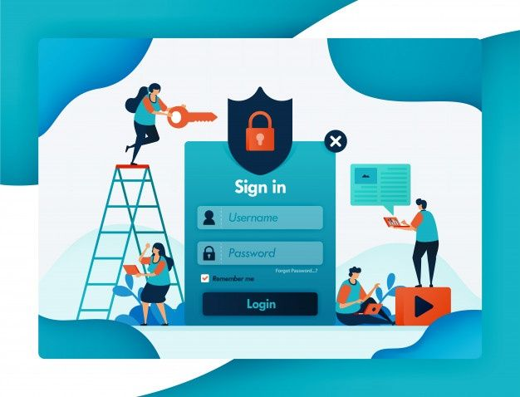
How a hacker directly monetized through attacking web consumer applications?
Protecting accounts on such a service is thus paramount for the site’s continued existence.

Slide 9
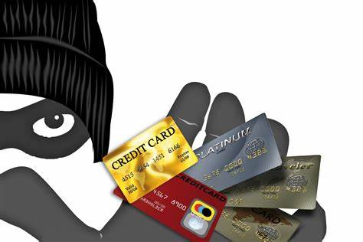
How a hacker directly monetized through attacking web consumer applications?
Fraud is another key concern for many consumer-facing websites.

Slide 10

How a hacker directly monetized through attacking web consumer applications?
Click fraud consists of bots or other automated tools clicking links for the sole purpose of increasing click counts.

Slide 11
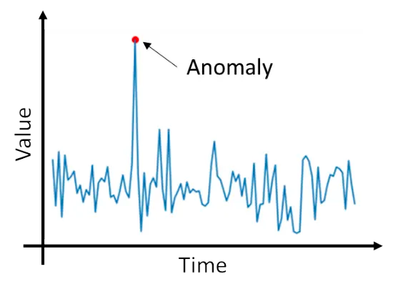
How a hacker directly monetized through attacking web consumer applications?
Anomaly Detection

Slide 12
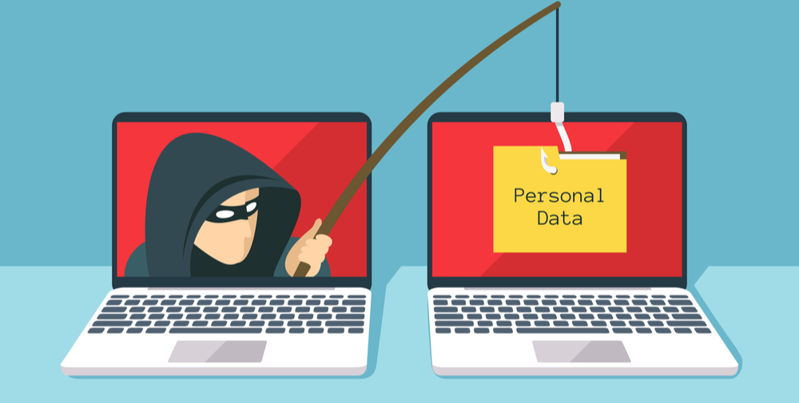

How a hacker indirectly monetized through attacking web consumer applications?
Phishing

Slide 13
Types of Abuse - Authentication and Account Takeover

Slide 14
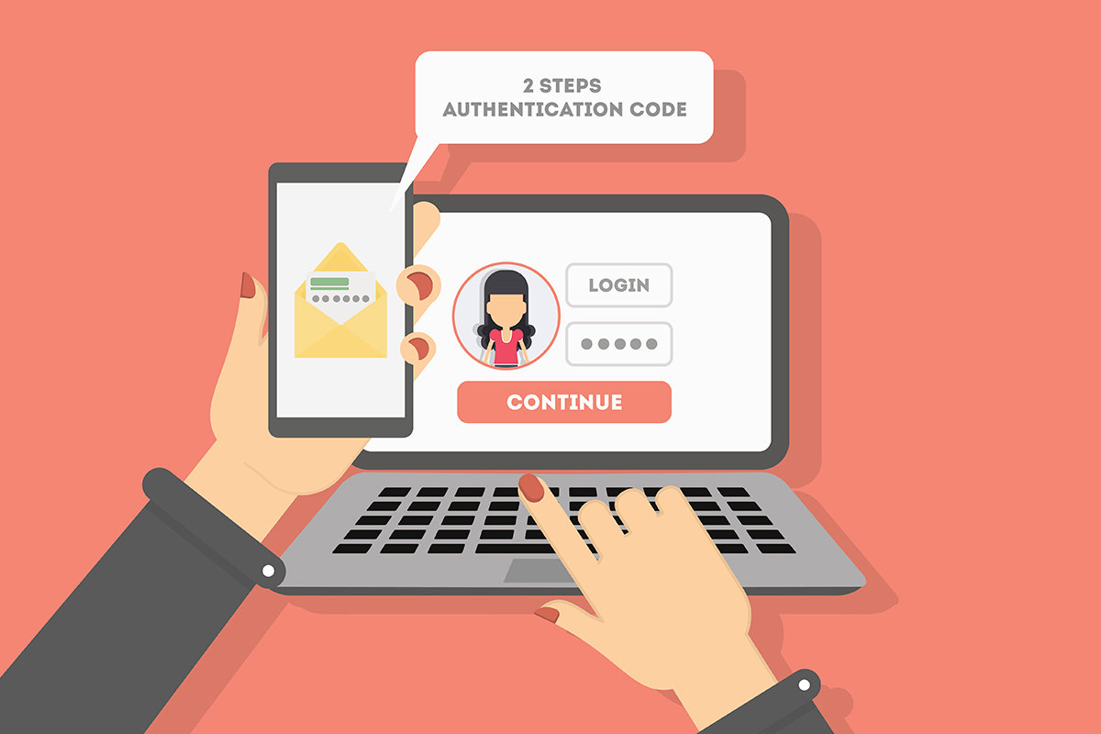
Authentication and Account Takeover
Authentication on the internet today overwhelmingly takes the form of passwords.
In the ideal situation, passwords serve to identify a user by verifying a snippet of information that is known only to that user.

Slide 15
Password Flaws
Users choose passwords that are easy to remember but also easy to guess.
Because it is nearly impossible to remember a unique, secure password for each site, people reuse passwords across multiple sites.
Users are vulnerable to “phishing” campaigns, in which a malicious email or website takes on the appearance of a legitimate login form, and tricks users into revealing their credentials.
Users might write down passwords where they can be easily read or share them with friends, family, or colleagues.

Slide 16
Features Used to Classify Login Attempts
Signals indicating a brute-force attack on a single account:
Velocity of login attempts on the account—simple rate limiting can often be effective
Popularity rank of attempted passwords—attackers will try common passwords
Distribution of password attempts on the account—real users will attempt the same password or similar passwords

Slide 17
Features Used to Classify Login Attempts
Signals indicating a deviation from this user’s established patterns of login:
Geographic displacement from previous logins (larger distances being more suspicious)
Using a browser, app, or OS not previously used by the account
Appearing at an unusual time of day or unusual day of the week
Unusual frequency of logins or inter-login time
Unusual sequence of requests prior to login

Slide 18
Features Used to Classify Login Attempts
Signals indicating large-scale automation of login:
High volume of requests per IP address, user agent, or any other key extracted from request data
Unusually high number of invalid credentials across the site
Requests from a hosting provider or other suspicious IP addresses
Browser-based telemetry indicating nonhuman activity—e.g., keystroke timing or device-class fingerprinting

Slide 19
Feature Engineering
Engineering all of these features is a nontrivial task; for example, to capture deviations from established patterns, you will need a data store that captures these patterns (e.g., all IP addresses an account has used).
Labeling account compromise is an imprecise science.
Let’s assume you don’t have any labeled data. How do you use the signals described here to detect suspicious logins?

Slide 20
Feature Engineering
The first technique you might try is to set thresholds on each of the aforementioned features.
For example, you could require extra verification if a user logs in more than 10 times in one hour, or more than 500 miles from any location at which they were previously observed or using an operating system they haven’t previously used.

Slide 21
Feature Engineering
How about a more principled, statistical approach?
Let’s take a step back and think about what we want to estimate: the probability that the person logging in is the account owner.
How can we estimate this probability?

Slide 22
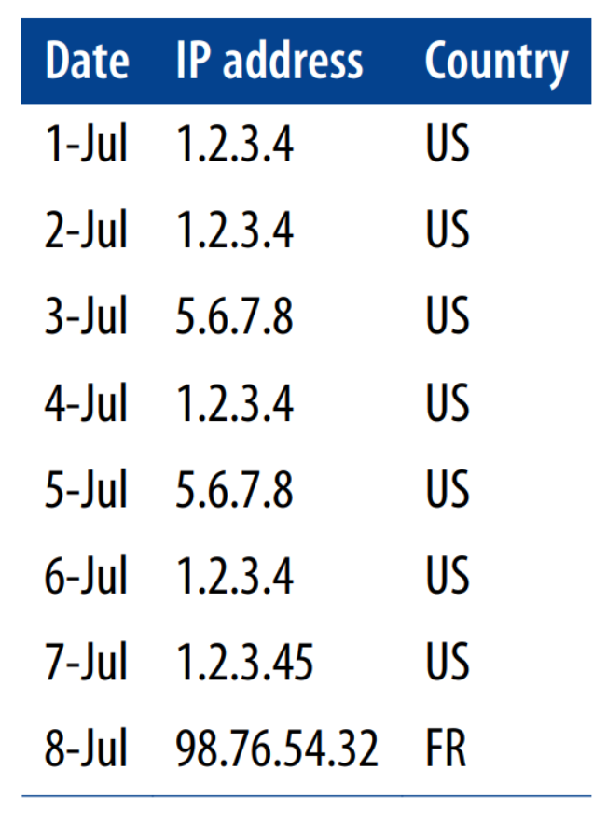
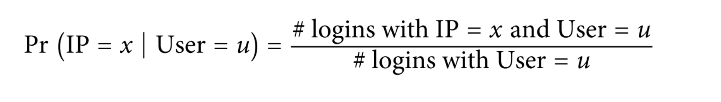
Feature Engineering
How can we estimate this probability?
Suppose that we have a user, u, who has the following pageview history:

Slide 23
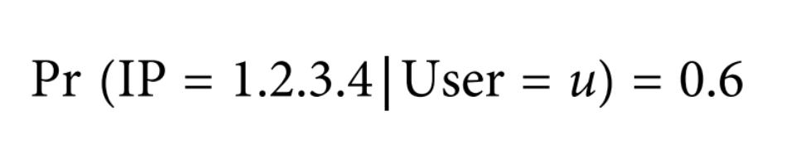
Feature Engineering
How can we estimate this probability?
For the login on July 6, we can compute the following:

Slide 24
Feature Engineering
How can we estimate this probability?
But what do we do with the login on July 7? If we do the same calculation, we end up with a probability estimate of zero.
If the probability of user u logging in from IP x is zero, this login must be an attack.
Thus, if we took this calculation at face value, we would need to regard every login from a new IP address as suspicious.

Slide 25
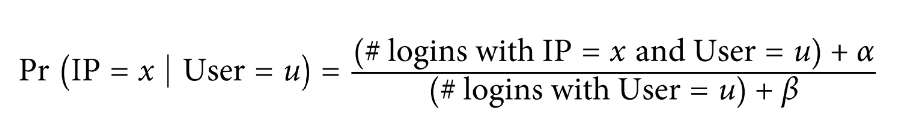
Feature Engineering
How can we estimate this probability?
To avoid the issue of zero probabilities, we can smooth by adding “phantom” logins to the user’s history.
Specifically, we add β login events, α of which are from the IP address in question.

Slide 26
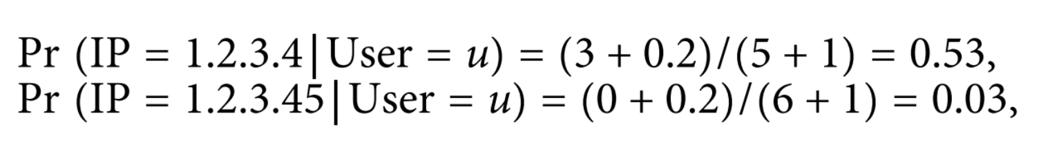
How can we estimate this probability?
The precise values of α and β can be chosen based on how suspicious we expect a new IP address to be, or, in statistical terms, what the prior probability is.
One way to estimate the prior is to use the data: if 20% of all logins come from IP addresses not previously used by that user, values of α = .2 and β = 1 are reasonable.
With these values, the logins from our imaginary user on July 6 and 7 get probability estimates of, respectively:

Slide 27
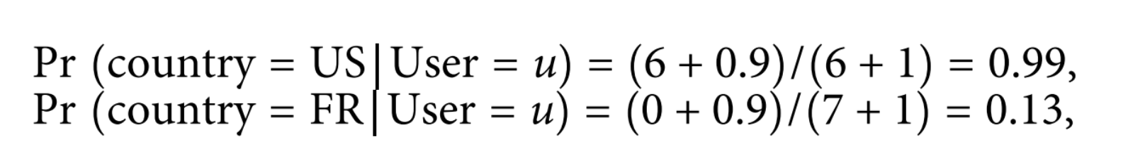
How can we estimate this probability?
Note that if we just look at IP addresses, the logins on July 7 and 8 are about equally suspicious (P = 0.03 for both).
Note that if we just look at IP addresses, the logins on July 7 and 8 are about equally suspicious (P = 0.03 for both).
let α = .9 and β = 1

Slide 28
How about the “large-scale automation” features?
To calculate velocity features, we need to keep rolling counts of requests over time that we can look up on each incoming request.
For example, we should keep track of the following (among others):
Number of successful/failed login attempts sitewide in the past hour/day
Number of successful/failed login attempts per IP address in the past hour/day
Number of successful/failed login attempts per user agent in the past hour/day

Slide 29
To determine whether there is an unusually high number of invalid credentials across the site:
calculate the login success rate for each hour over a sufficiently large historical period and use this data to compute the mean and standard deviation of the success rate.
compute the success rate over the past hour and determine whether this value is acceptably close to the historical mean.
using heuristics, failure rates two or three standard deviations above the mean should trigger alerts or additional friction.
To get a probability, you can use a t-test to compute a p-value. You can compute similar statistics on failure rate per IP or failure rate per user agent.

Slide 30
“requests from a suspicious entity” features:
To accurately capture these features, you need reputation systems that assign to each entity (e.g., IP address) either a label or a score that indicates the prior level of suspicion.
(For example, hosting providers would typically have low scores.)

Slide 31
The Classifier
Without labels: anomaly detection.
With labels: supervised classifier.
Typically, your labels will be highly unbalanced (there will be very little labeled attack data), so you will want to use a technique such as undersampling the benign class or adjusting the cost function for the attack class.

Slide 32
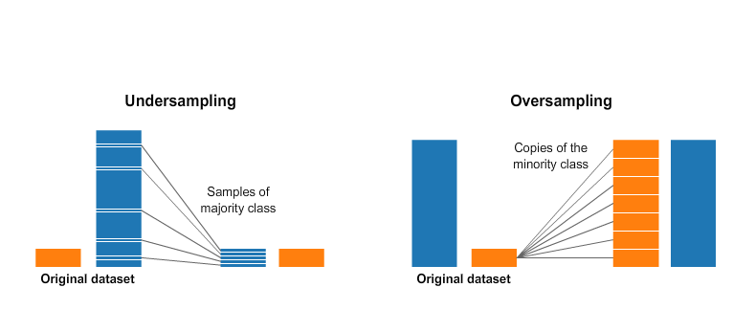
The Classifier

Slide 33
Unit V – Web System Protection (1)
Outline
What is required to protect a consumer Web?
Types of Abuse - Authentication and Account Takeover

Slide 34
Computational Intelligence (TC2023)

